Slide 1
BASIC TEXT GENERATOR USING AI MODEL
SHRANYA GUPTA
2300290100238
3-D
CSE

Slide 2
ABOUT THE PROJECT
This project uses Basic Python, text generation as prerequisites to create a text generating tool in python script.
It asks the user for a prompt and then generate the text accordingly.
This project makes use of the OpenAI language model to ask for the prompt and then generate text according to prompts specified by users. It uses GPT-2 as a powerful transformer-based model.
Next slides show the usage of this project.

Slide 3
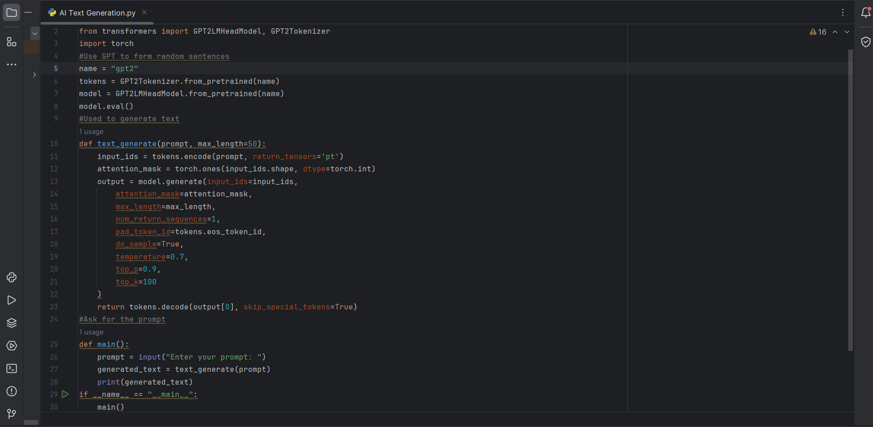
Python program using libraries like Transformers and PyTorch to generate text

Slide 4
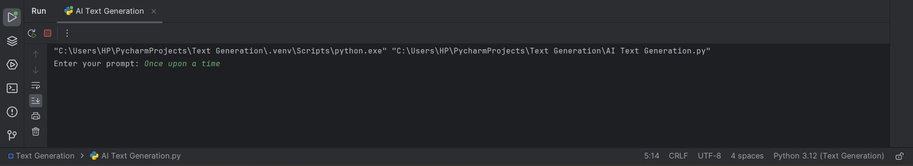
After running the program we ask the user to enter a prompt

Slide 5
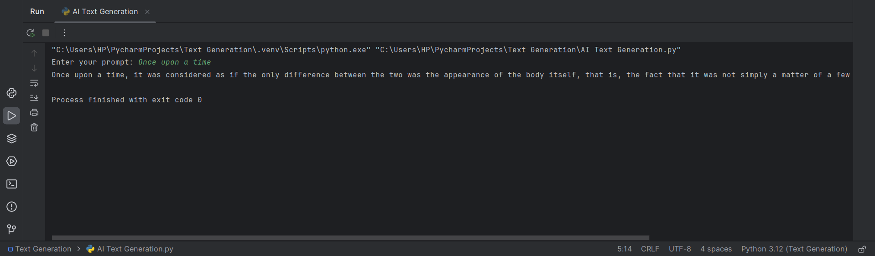
The Text Generator uses the GPT2 model to generate text according to the prompt

Slide 6
CONCLUSION
This program is a simple and basic way to generate text when asked a prompt from the user.In practice, we can use Microsoft Azure, PowerApps (to create a app with this program), PowerAutomate etc. can be used to create a more complex application.

Slide 7
THANK
YOU

